Slide 1
Identifying where we should open a high-end fitness centre in Toronto
July 2021
Mike Mehta

Slide 2
Problem definition
Primary objective: Identify where our client should develop a new high-end fitness facility that has minimal competition and has favourable surrounding neighbourhood traits to support a
Secondary objectives:
1. Understand the current competitive market
2. Advise a business plan given other current succesful facilities

Slide 3
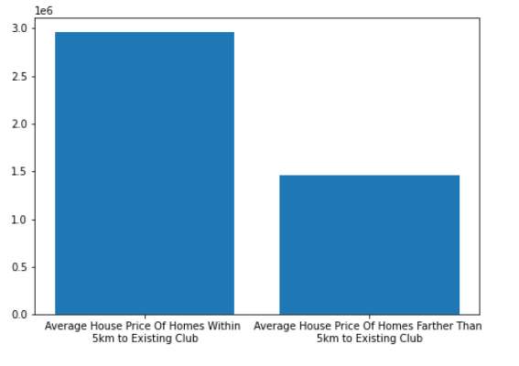
Areas near existing clubs are substantially more expensive than areas away from clubs
Average House Price Near and Away From Existing Clubs
Existing clubs exist in neighborhoods that are much more expensive than neighbourhoods that do not have a club.
The average house in Toronto is about $2M. The average price within 5km of an existing club is $2.9M, and outside a 5km radius is $1.5M.
The reason for this is likely desired client base of these clubs and the fees that they charge. Indicating this fitness club will also likely need to be in an area that is similarly wealthy

Slide 4
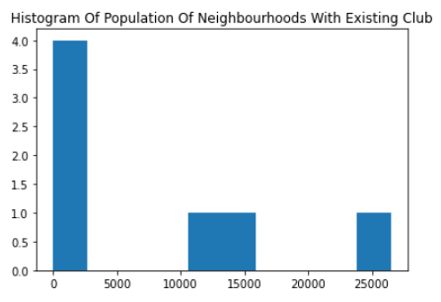
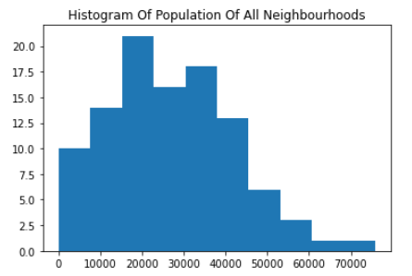
Population density of existing clubs falls into 3 distinct buckets
Looking at population surrounding the clubs, we can see that the fitness clubs fall into one of a few categories.
Commercial: Downtown in a very commercial area such as Toronto Athletic Club, Equinox Club or Adelaide Club. Where there are few residences, but a lot of business and daily foot traffic. These have low populations in the surrounding neighborhood.
Residential: In strictly residential areas amongst primarily detached homes, reducing population density, such as The Granite Club and Rosedale Club. These have mid-level populations but are extremely affluent.
Hybrid: In a downtown residence area that include multi-unit homes such as condos. These are a both close to expensive homes (Yorkville is an expensive neighborhood) and also pretty close to the financial sector similar to group 1. They likely cater to both the white-collar financial district workers coming to and from work as well as the people who live in the surrounding areas.

Slide 5
Clustering these neighbourhoods
A few notes:
- We ran a k-means cluster with various k to determine where the optimal neighborhood would be. We want to look for stable groupings. Ultimately, we used k 2-6.
- We treated established luxury Toronto fitness clubs as our ‘success’ to help guide the model
- Variables included in the clustering were local house prices (as a proxy to affluence), local population, and foursquare neighbourhood amenities (like parks and cafes)

Slide 6
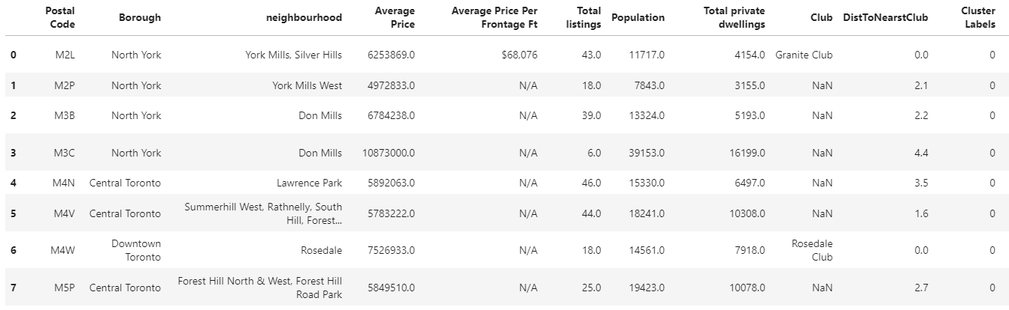
Clustering results -- Residential
Increasing the clustering up to 6, we see a familiar trend breakout where there are 3 clusters with clubs. These clubs are aligned with the population density mentioned above.
Firstly, to the left, we have the residential focused cluster. These neighbourhoods are some of the most expensive in Toronto, with relatively small populations as they are almost all single family homes on larger lots. Unfortunately, all these neighbourhoods are within a short distance to existing clubs, making expansion here less feasible as clients would need to be taken from established facilities
Cluster with existing residential-focused clubs

Slide 7
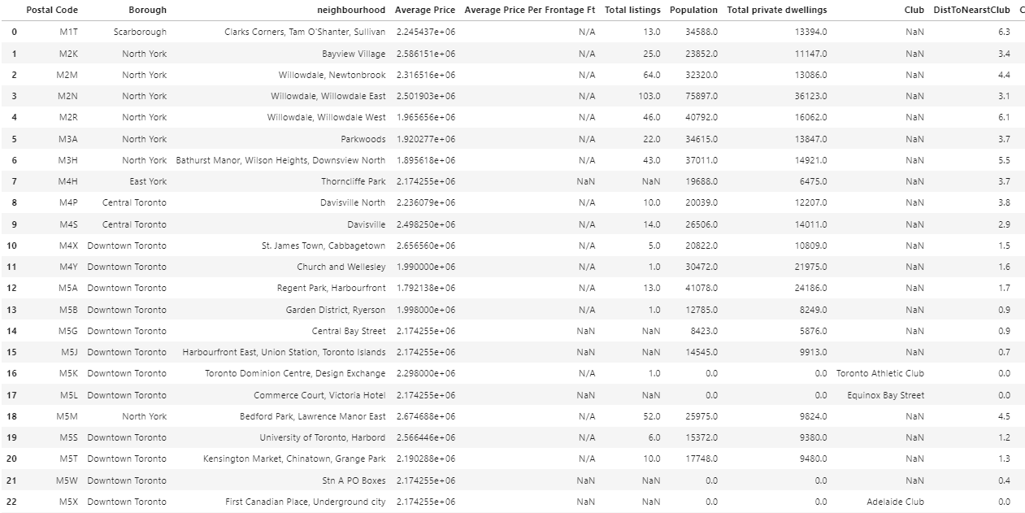
Clustering results -- Commercial
Next we have the commercial clubs. These are in the downtown core, with fewer people living directly in the neighbourhood. Instead they achieve success by focusing on white-collar workers who have nearby employment
Similar to before, these neighbourhoods represent a small geographic area that is already covered by existing clubs, making the competitive intensity high
Cluster with existing commercial-focused clubs

Slide 8
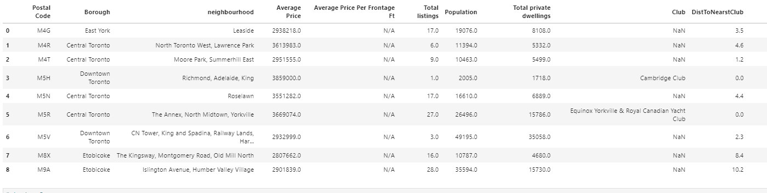
Clustering results -- Hybrid
The last of the existing club clusters is the Hybrid. These are in areas with both a decent local population and a fair bit of white collar commercial activity.
While many of these are downtown and central Toronto, we see postal codes M8X and M9A that are 8-10km west of the down town core in Etobicoke.
These benefit from wealthy locals, local commercial buildings as well as being on a transit hub being right on Bloor, making it easy to stop at on potential customers commute.
Cluster with existing hybrid-focused clubs

Slide 9
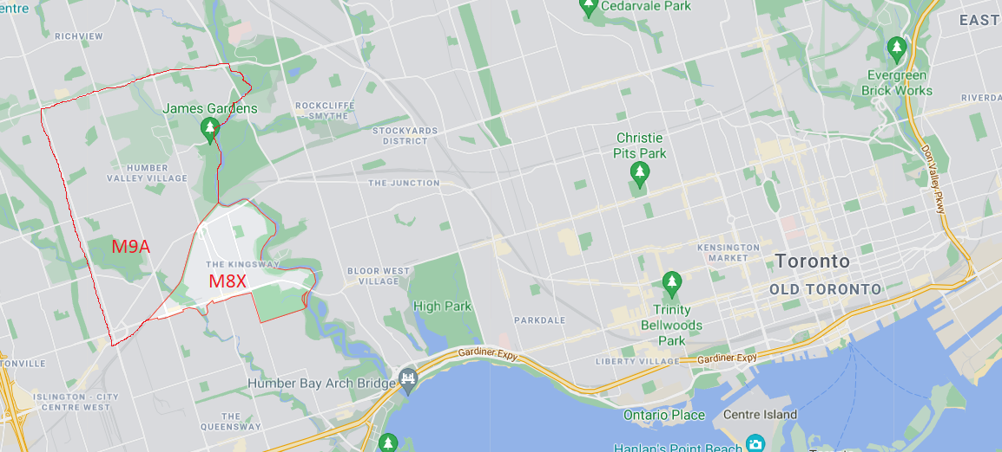
Conclusion
We analyzed every FSA in Toronto and came to the conclusion that we will advise our client that postal codes M8X and M9A are the most promising to open a new high-end fitness facility. These areas have a large affluent local base, but are still near commercial activity and are easily accessible being on the subway line. Furthermore, based on the clubs in the same cluster as these postal codes, the successful niche would be one of a hybrid model that tries to do work for both families as well as white-collar professionals on their way to or from work.

